Slide 1
Llama.cpp RISC-V Support
曾子瑄
2024.05.11
Notes:
照片为学生拍摄的礼堂

Slide 2
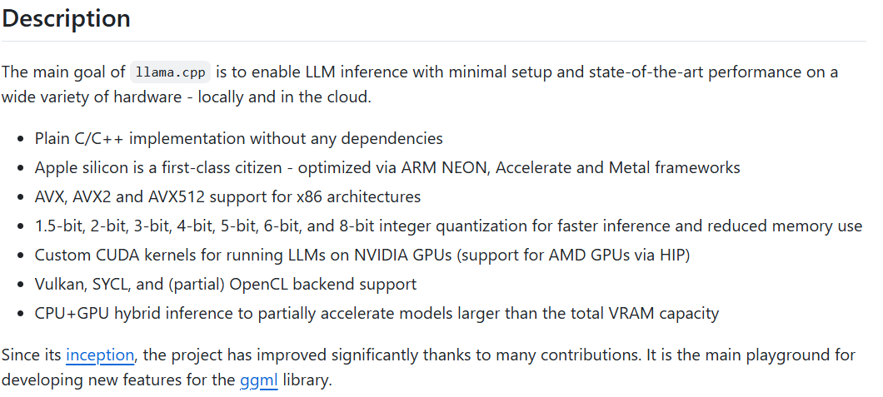
What is Llama.cpp

Slide 3
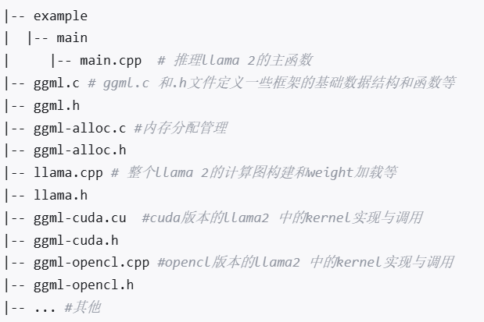
Llama.cpp Arch
Llama.cpp
ggml
gguf
Code Structure

Slide 4
Llama.cpp Inference Pipeline
model file
main file
path:llama.cpp/examples/main/main.cpp
convert file
path:llama.cpp/convert.py
quantize file
path:llama.cpp/example/quantize/quantize.cpp
fp16 gguf file
int4 gguf file
parse args
llama_token_bos()
:use 1 bos token
llama_eval()
path:llama.cpp/llama.cpp
llama_eval()
:Init model
llama_eval_internal()
:different inference mode
while
llama_build_graph()
llama_eval()
:inference
ggml_graph_compute_helper()

Slide 5
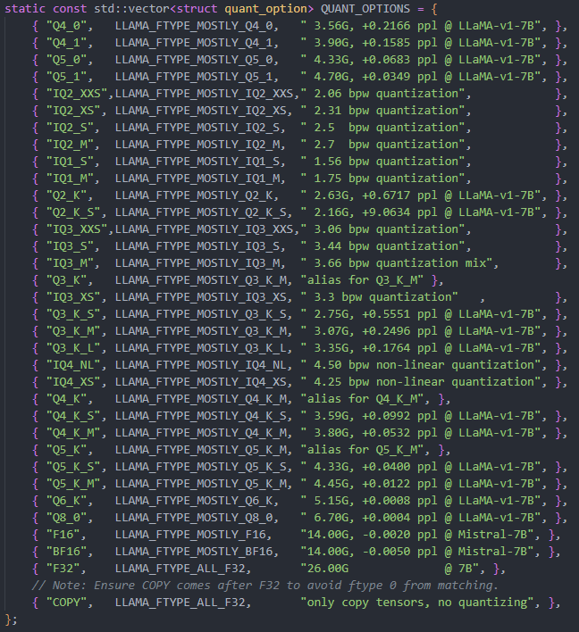
Llama.cpp Quantization
数字后缀
0：对称量化
1：偏移量化
K后缀（K-quants）：二级参数量化
IQ 前缀（gguf importance matrix (imatrix) quants）：通过imatrix进行不规则映射，用于低位量化
Vanilla量化步骤：
分块，分为chunk和block，可以并行
block内求|max|
根据max求放缩系数
round映射为int
量化特点：
均为WxA16
方法稳定实用
缺乏论文支撑
Offline Quantization
Quant Options

Slide 6
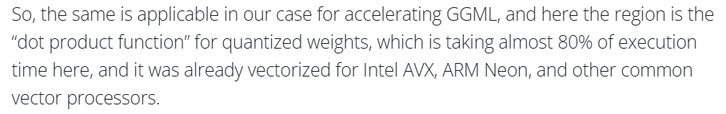
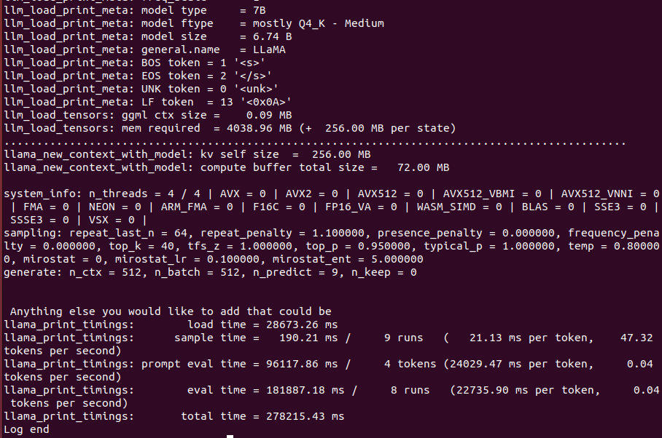
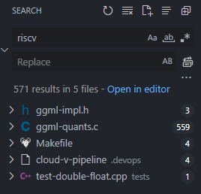
Llama.cpp RVV Support
RVV Support
Related Functions：
ggml_vec_dot_q4_0_q4_0
ggml_vec_dot_q4_1_q8_1
ggml_vec_dot_q5_0_q8_0
ggml_vec_dot_q5_1_q8_1
ggml_vec_dot_q8_0_q8_0
[GGML] Added RISC-V Vector Intrinsics Support by Tameem-10xE · Pull Request #2929 · ggerganov/llama.cpp (github.com)
riscv code in llama.cpp
https://cloud-v.co/blog/risc-v-1/accelerating-llama-cpp-with-risc-v-vector-extension-3

Slide 7
Llama.cpp RISC-V K-Quants Support
Newly Support Functions：
ggml_vec_dot_q2_K_q8_K
ggml_vec_dot_q3_K_q8_K
ggml_vec_dot_q4_K_q8_K
ggml_vec_dot_q5_K_q8_K
ggml_vec_dot_q6_K_q8_K
quantize_row_q8_0
quantize_row_q8_1
有效性与框架适配度（已弃用）
Matrix extension support ggml format
qemu-riscv64
Optimized Previous Functions：
ggml_vec_dot_q4_0_q8_0
ggml_vec_dot_q4_1_q8_1
ggml_vec_dot_q5_0_q8_0
ggml_vec_dot_q5_1_q8_1
https://github.com/Tameem-10xE/llama.cpp
Added RISC-V Vector Support for K-Quants and improved the existing intrinsics by Tameem-10xE · Pull Request #3453 · ggerganov/llama.cpp (github.com)
by fractional LMUL(i.e. 1/2)

